Slide 1

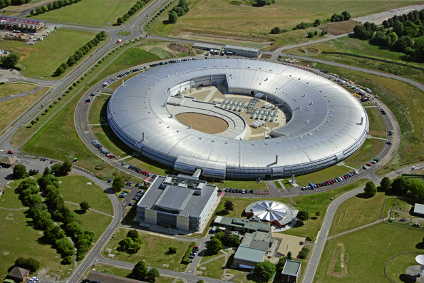
EPICS V4 for Diamond Detector Data
Dave Hickin
Diamond Light Source
EPICS Developers Meeting
Saclay 21/10/2014

Slide 2
Objectives
Lossless high-performance transfer of detector data and camera images including metadata
Software infrastructure to support it
Framework for high performance scientific data services
Incremental development
  Based on areaDetector

Slide 3
Why transfer detector data?
Transferring data between platforms
(Usually from Windows to Linux)
  Cameras often have Windows only support
  Better support for HPC in Linux, e.g. HP file system
  Linux toolchain
  Preference for Linux (open source, reliability etc.)
  More expertise on Linux
Distributing processing

Slide 4
Case Study – I12 Beamline
I12 Beamline at Diamond
  Joint Engineering, Environmental and Processing(JEEP)
  Imaging, Tomography, X-ray diffraction, SAXS
PCO detector, Windows-only support
HDF5-writer, Lustre distributed files system
~90 10MB images per second
10 Gig Ethernet

Slide 5
Why use EPICS V4
EPICS V4 adds structured data. Allows metadata to be kept with image data
  Image dimensions
  Colour attributes
  Experiment and system metadata
  Compression/encoding information
Integrates with other EPICS developments, e.g. CSS.

Slide 6
areaDetector overview
Provides a general-purpose interface for detectors and cameras in EPICS
Easily extensible
Supports wide variety of detectors and cameras
High-performance
Mechanism for device-independent real-time data analysis

Slide 7
areaDetector overview (cont)
Camera drivers inherit from base class ADDriver
Drivers produces NDArrays
Run plugins
Plugins inherit from NDPluginDriver
Connect to asyn port on a driver
Consume NDArrays

Slide 8
NDArray
1-d type array of numeric type
Dimension information
ID and time stamps
Attributes
Also has Array Pool (but not part of “data”)

Slide 9
NDArray
Dimension
  Converts 1-d array to N-d array
  Describes how array is part of larger array
  Has size, offset, reverse and binning fields
ID and timestamps
  Unique ID – integer unique to frame
  Time stamp (from driver)
  2nd time stamp

Slide 10
NDArray
Attributes
  A linked list of heterogeneous type.
  Each attribute has name, description, source, source type and value
  Source type can be driver, parameter library, EPICS PV or user-defined function
  2 standard attributes colorMode and Bayer pattern. Color Mode turns 3-d array into 2-d colour image
  Attributes can describe image, contain info such as camera parameters or current value of PV

Slide 11
areaDetector and EPICS V4
areaDetector runs a plugin which is a pvAccess server
Plugin translates NDArrays into EPICS V4 structured data (normative type). Closely maps to NDArray
pvAccess used to transfer data
V4 client implements ADDriver
Translates V4 type back into NDArray
Passes NDArrays to plugins
Existing plugins run remotely

Slide 12
EPICS V4/AD Development
EPICS V4 Initial Prototype
  Server-side plugin and client-side driver
  Uses pvAccess and EPICS V4 core code
  Client monitors PV
  Linux only. Not running on Windows yet
  Initially coding based on pvAccess testServer
Further development
  Turn into robust solution
  Integrate with other developments
  Enhancements

Slide 13
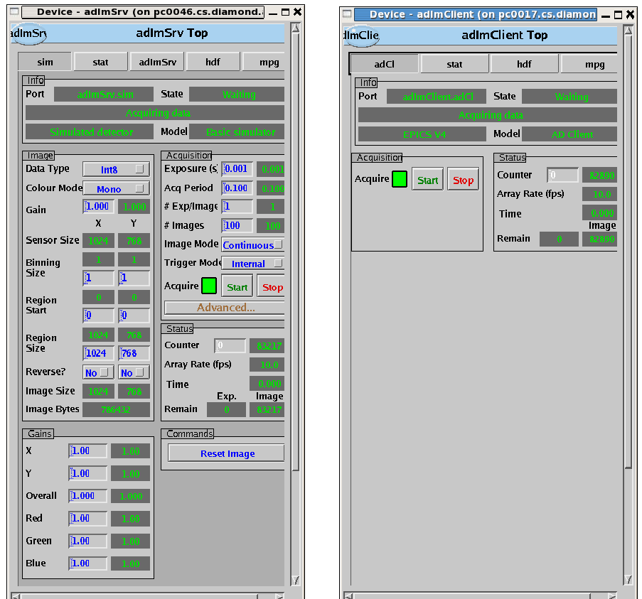
EPICS V4 Server and Client Prototype

Slide 14
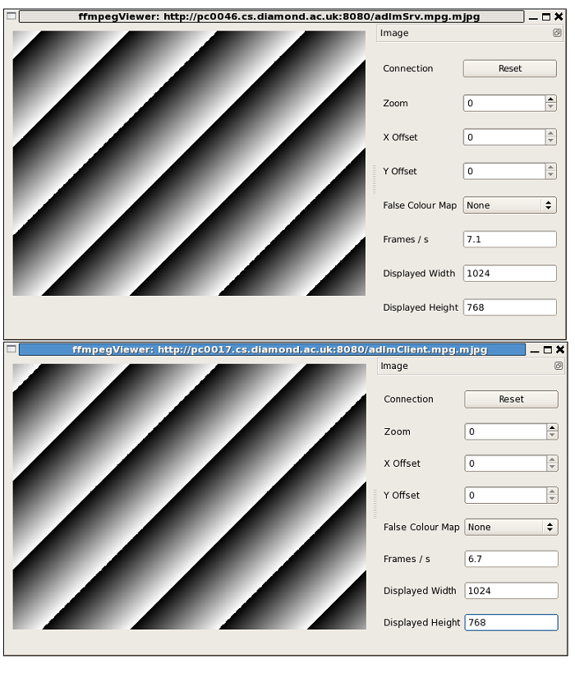
Prototype: Images

Slide 15
Recent Work
Increased performance. Tested on 10 Gig Ethernet
Investigation and implementation of compression
  Server-side plugin uses pvDatabase instead of testServer and new client written
  Improved reliability. Helping to debug EPICS V4 core
  Defined new normative type (NTNDArray) to replace old type (NTImage)
CSS integration and pvaSrv
Prototype V4 SimDetector

Slide 16
Compression
Compression algorithm applied to image data
Add compression info to V4 structure
Allows effective bandwidth to exceed physical
Used freely available compression libraries.
  An LZ4 library
  Blosc (multi-threaded compression)
Combined LZ4 algorithm with Blosc

Slide 17
Performance on 10 Gig Ethernet
Setup
  2 High Performance Linux PCs, connected by direct fibre 10 Gig Ethernet
  SimDetector (modified) producing 3192x3192 images running V4 plugin on one machine
  V4 client driver on other machine running stats hdf5 and mpeg plugins

Slide 18
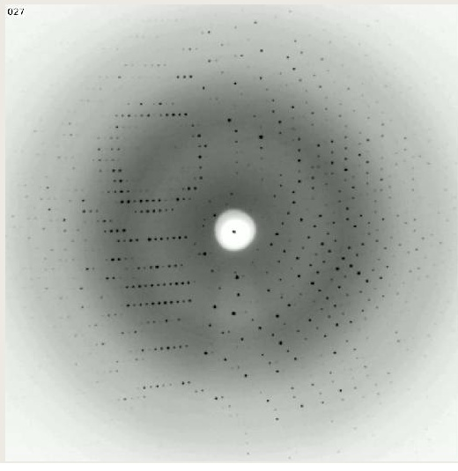
simDetector Image

Slide 19
Performance on 10 Gig Ethernet
  Uncompressed
    120-122 frames per second (97-99+% bandwidth)
Compressed
  With compression image reduced to 36% of original size using lz4 and 38% by Blosc
  Single threaded compression reduces performance
  Blosc-based compression (multithreaded) increases rate
  Blosc + lz4 best. Up to ~230 frames per second (190% of bandwidth)

Slide 20
NTNDArray
  EPICS V4 structure for detector data
  Normative type
  1 NTNDArray gives 1 frame
Maps closely to NDArray
Dimension data, time stamps, uniqueId, attributes
Adds codec information
Uses unions for image data and attribute values
Uses structure arrays for dimensions and attributes

Slide 21
V4 SimDetector
  Prototype V4 SimDetector
Puts image direct into V4 structures instead of NDArray. Publishes image as PV
V4 areaDetector client monitors and runs plugins
Clients can run remotely or locally in the same or different process
V4 can provide many of the functions provided by areaDetector (monitor queues, reference counted arrays)

Slide 22
Current and near future work
  Complete move to NTNDArray from NTImage
  Move to GitHub Module - ADPvAccess
  Package and release
  Integration with other EPICS developments especially CSS
  Windows build
  Deploy on beamline (I12 is candidate)

Slide 23
Possible future development of areaDetector/V4
Group images from multiple detectors into single image
Modify areaDetector drivers to put images directly into NTNDArrays instead and plugins consume these.
Other compression options
Alternatives: GStreamer

